Slide 1
Problem Statement
FinMan is a company already providing financial services like loan, investment funds, insurance etc. to its customers. They want to sell health insurance too to their customers. Problem Statement is to predict the customers to whom health insurance poliices can be offered.

Slide 2
Flow
About data
Data Analysis feature importance
Data Pre-processing
Feature Engineering
Final Model
Feature Importance
Result

Slide 3
Data Dictionary
Data was provided about customers in these columns
- Demographics (city, age, region etc.)
- Information regarding holding policies of the customer
- Recommended Policy Information

Slide 4
About Data
Data had train and test set with 50882 and 21895 rows with 14 columns
Where Response (Target variable) 0 : Customer did not show interest in the recommended policy, 1 : Customer showed interest in the recommended policy

Slide 5
Data Exploration Analysis
After doing EDA , there were missing values in three coliumns (would be treated in preprocessing part)
Ater doing EDA, all columns did gave an insight into customer behavior but Reco_Policy_Type which was Encoded value for recommended health insurance was most useful to understand the data at the time of EDA and city code was a good feature too in identifying customers better

Slide 6
Data pre-processing
In data preprocessing, substituted the null values of holding_account_duration as 0, since we have some new customers too, so assuming the null info as 0(equivalent to new customer)
So was holding_account)type null type were replaced by "no prior info"
The "health indicator missing values were substitued as "Not Known" as there was some relation between all the missing values rows simuntaneously, so in preprocessing kept it as "not known"
Converted the data types of columns according to the type of columns, for example holding accomodation type to be categorical

Slide 7
Feature Engineering
A trend was seen that, which customer did not have duration info in account holding, the type wasnt even mentioned, and we substitued the duration as 0 assuming to be new customer, so made a NEW COLUMN name customer type with two values of old and new, new wherever duration and type were 0
Made another new column as Age-differ , subtraction of upper and lower age, and a column was further made on age-dofference column analysis, it was obsereved that, wgerever the age diff was 0, those people had no spouse and the reco_insurance_type was also indiviual, so a new column was made where marked 1 on that basis pecfocally.
New column named city_Region_intraction was made concating both column values to uniquely idntify the areas of customer

Slide 8
More Feature Engineering
Four new columns were made using Accomodation type of owned and rented, reco_insurance_type of inddiviual and joint, and using is_spouse of no and yes columns
1 and 0 were allocated for above catefoires in respective columns and then new four columns were made, on combining accomodation, reco_insurance by multiplying the values, to better undersatnd more customer data, which values give 1, and if either one of the mulplied value is 0, the value in new col becomes 0 and similarly three more using combo of acco-spouse , reco_insu-spouse, acc-insurance-spouse
Four further columns were made on adding the values of abpve columns

Slide 9
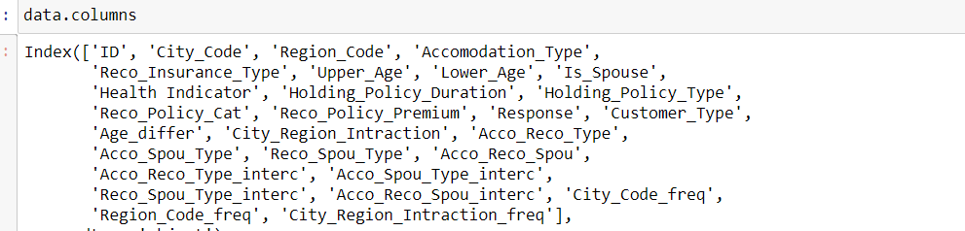
Total Columns

Slide 10
Model
Training, val and testing data, validation data of 25%
CatboostClassifier used as a final model
Which gave an accuracy of 0.80111 on validation set and 0.812 on leaderboard.

Slide 11
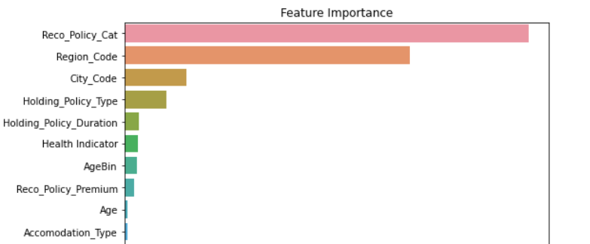
Result after Modeling
As per analysis too, the
model too showed that
Reco_Policy_Cat along with
Demographics of a customer
Was able to help in better prediction, followed by what type of account did the person already hold in the past independent of the age of the person.

Slide 12
Result
FinMan can be benefited witnh looking at Reco_Policy_Cat variable the most, that variable sells most the informations[ecaially 22 17, 12, 5 labelled ones.
Denorgraphics help in underatnding the nature more, people from ceratin areas help a lot in positive response of the acceptance of health insurance.
Age wasn’t an important variabke at all
Sales can be hiked for health insurance using Reco_policy variable sold at particular city and regio combo more.

